Slide 1
Market Update
August 27, 2021
Prepared by:
Portfolio Strategies Group
PFM Asset
Management LLC
213 Market Street
Harrisburg, PA 17101
717.232.2723
pfm.com

Slide 2
COVID Variants Presenting a Greater Concern for Economic Growth
United Kingdom
United States
Japan
World
India
Source: John Hopkins University Coronavirus Resource Center, PFM calculations; as of 8/23/2021.

Slide 3
U.S. Economy Added 943,000 Jobs in July, Jobless Rate Falls to 5.4%
Source: Bloomberg, as of 8/06/2021. Data is seasonally adjusted.

Slide 4
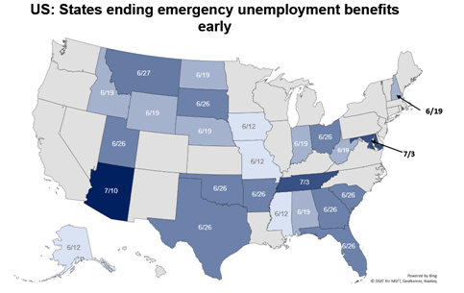
Emergency Unemployment Benefits Are Set to Expire Soon
Source: Oxford Economics and Haver Analytics, as of 6/14/2021.

Slide 5
Q2 GDP Disappoints, But Consumer is Strong
Official Q1
Third Estimate:
6.4%
Official Q2
First Estimate:
6.5%
Source: Bloomberg, as of 8/02/2021.

Slide 6
Inflation Is Spiking, But Investors Appear To Believe Rise Is Transitory
July ’21
5.4%
Source: Bloomberg, data for July 2021.

Slide 7
Fed Kept Interest Rate Near Zero and Asset Purchases at $120B/month
“…the Committee seeks to achieve inflation that averages 2 percent over time… following periods when inflation has been running persistently below 2 percent, appropriate monetary policy will likely aim to achieve inflation moderately above 2 percent for some time.”
Treasury
Mortgage-Backed
Federal Agency + Other
$8.2 trillion
Fed’s 2% Inflation target
Fed Fund Futures prices in a rate hike early 2023
Source: Bloomberg, as of 8/02/2021 (chart). Fed Funds Futures projections as of 8/02/2021.

Slide 8
Long-Term Yields Falling Despite Inflation Fears and Possible Tapering
Source: Bloomberg, as of 8/23/2021.

Slide 9
Treasury Yield Curve Flattens
U.S. Treasury Yield Curve
Source: Bloomberg, as of 8/23/2021.
Notes:
3- Mo +0.05% WoW

Slide 10
S&P 500 Has Not Fallen 5% From Peak Level Since November 2020
20.2%
2021 YTD Total Return
Source: Bloomberg, as of 8/23/2021.

